Slide 1
Law Office Network
By: Andrew Wright
CIST 1401 Spring 2026

Slide 2
Network Design Overview
2 Internet Services Providers are to be utilized. The main is AT&T Business Internet. The second ISP being Comcast Business is for redundancy and will be inactive, but on standby in the event of an outage.
Cisco products are exclusively used for interconnectivity and interoperability.
The office is segmented into VLANs for corporate data, voice, corporate Wi-Fi, guest Wi-Fi, printers/IoT, security/IoT devices (RFID readers, environmental monitoring, and limited camera coverage), internal servers, management, and the DMZ. Azure cloud backup is shown as the off-site recovery target.

Slide 3
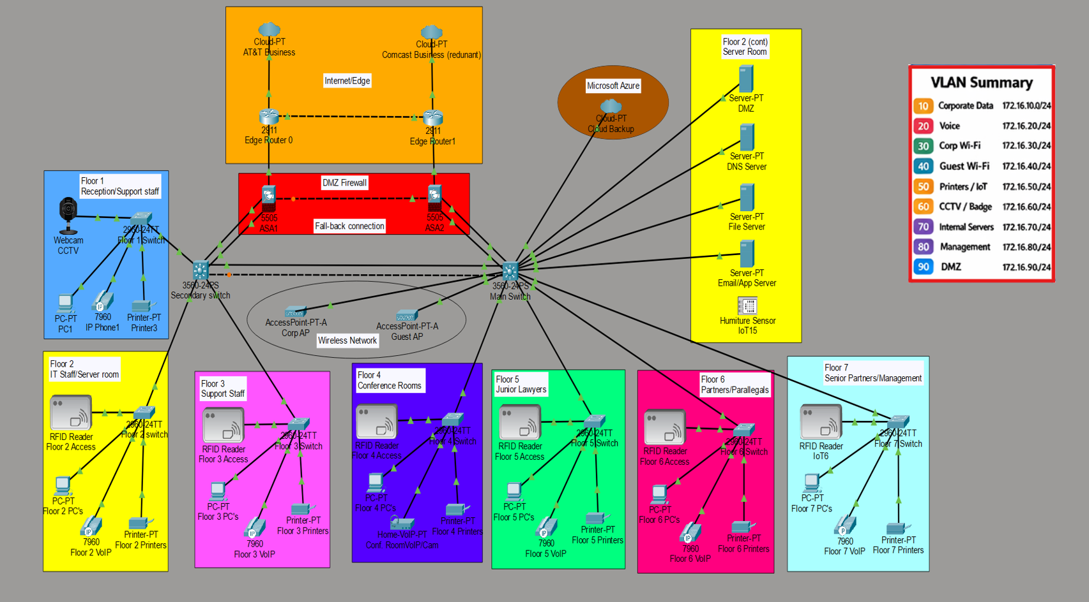
Network Topology Map
All components were configured to real-world specifications, with all components of my design function successfully.
Made using Cisco Packet Tracer

Slide 4




Floor Segmentation
Floor | Staff Type | Recommended network build | Special notes
1 | Reception/ support staff | 1 representative 2960 access switch, PC, IP phone, printer, limited CCTV webcam | Reception-focused floor, CCTV cameras
2 | IT staff / server room | 1 representative 2960 access switch, PC, IP phone, printer, RFID reader | Server-room zone is associated with IT floor
3 | Support staff | 1 representative 2960 access switch, PC, IP phone, printer, RFID reader | Standard support-floor with additional user workspace, if needed
4 | Conference rooms | 1 representative 2960 access switch, PC, conference VoIP/camera endpoint, printer, RFID reader | Conference-focused floor with Web and Voice IP communications
5 | Junior lawyers | 1 representative 2960 access switch, PC, IP phone, printer, RFID reader | Standard attorney-floor
6 | Partners/ paralegals | 1 representative 2960 access switch, PC, IP phone, printer, RFID reader | Mixed partner and legal support floor
7 | Senior partners/ management | 1 representative 2960 access switch, PC, IP phone, printer, RFID reader | Executive floor with representative user, phone, and printer

Slide 5

Network Map Segmentation Strategy
VLANs used: Data, Voice, Corp Wi-Fi, Guest Wi-Fi, Printers/IoT, Security/IoT, Servers, Management, DMZ
Main 3560-24PS core switch performs inter-VLAN routing
Secondary 3560-24PS extends VLANs to floor switches using trunk links
DHCP relay sends client requests to the DHCP/DNS server
DMZ web server isolated on VLAN 90
Internal servers located in the Floor 2 server room
Azure Backup provides off-site recovery and backup
VLAN | Section | IP/Subnet layout
10 | Corporate Data | 172.16.10.x/24
20 | Voice | 172.16.20.x/24
30 | Corp Wi-Fi | 172.16.30.x/24
40 | Guest Wi-Fi | 172.16.40.x/24
50 | Printers / IoT | 172.16.50.x/24
60 | Security (RFID/CCTV) | 172.16.60.x/24
70 | Internal Servers | 172.16.70.x/24
80 | Management | 172.16.80.x/24
90 | DMZ | 172.16.90.x/24

Slide 6
Security Design Aspects
Physical security | Network security
Badge-controlled access to exterior doors, MDF, and every floor IDF | Cisco Secure Firewall IPS/IDS, malware and web filtering, VPN, east-west ACLs, DNS-layer protection, and logging to SIEM
Visitor sign-in and escort policy | 802.1X for wired and wireless access, WPA3-Enterprise for secure SSIDs, Duo MFA for privileged/admin access
CCTV coverage in lobby, elevator areas, and equipment rooms | Separate guest SSID with internet-only access
Locked racks, UPS-backed rooms, environmental monitoring | Endpoint protection, Multifactor Authentication (MFA), conditional access
Security guard / lobby desk during business hours | Centralized logging, vulnerability scanning, and quarterly access reviews

Slide 7
Equipment Overview
Category | Recommended equipment | Qty | Notes
Edge security / routing | Cisco Secure Firewall HA pair | 2 | NGFW, IPS, VPN, SD-WAN, web filtering
Core switching | Cisco Meraki MS425 or Catalyst core pair | 2 | Redundant campus core / aggregation
Access switching | Cisco Meraki MS130/MS150 48-port PoE | 28 | 4 per floor for user/phone/AP growth
Wireless | Cisco Meraki CW9162I Wi-Fi 6/6E | 56 | About 8 APs per floor
Laptops | Dell Latitude 5450 | 261 | Attorneys and IT
Desktops | Dell OptiPlex 7020 Micro | 307 | Administrative and support staff
Printers | HP LaserJet Enterprise / Managed Print mix | 28 | Approx. 4 per floor plus specialty units
Desk phones | Cisco 8875 or Webex softphone mix | 575 | Mix of desk phones and softphone licensing
Conference rooms | Cisco Webex Room Bar / Room Kit | 7 | One per floor conference room
Servers/virtualization | Dell PowerEdge + VMware/Hyper-V cluster | 6 | Core server and infra workloads

Slide 8
Production & Support Cost
Category | What is included | Estimated cost
Network equipment | Cisco firewall edge, core/access switching, wireless, limited physical-security/IoT endpoints, UPS/rack power | $612,800
VoIP phone services | Webex Calling licenses, desk phones, conference-room voice reserve | $188,400
Network connectivity | Structured cabling, fiber riser, dual-carrier internet reserve | $740,250
Computers | 261 laptops + 307 desktops | $753,249
Routers | Representative in Packet Tracer as Cisco 2911 edge routers | $64,000
Printers | HP fleet plus spares | $39,500
Servers | Dell virtualization cluster, storage, backup server, Windows licensing | $226,000
Software / cloud / backup | Microsoft 365, Azure backup/archive, documentation/tooling reserve | $368,000
Implementation / support reserve | Installation labor, configuration, testing, documentation, 36-month support reserve | $410,000
Estimated total 36-month production project cost: $2,930,139

